Slide 1
Jacquard Knitted Uppers Design Development
By Zoe Newman
North Carolina State University
Fall 2019 – TTM 591

Slide 2
Technical Information
Machine: SIR 123-SC
Bed Length: 120
Machine Type: SC
Cams: 3
Gauge: 18
Carrier Options: Extension (+15)

Slide 3
Package
2 Color Jacquard

Slide 6
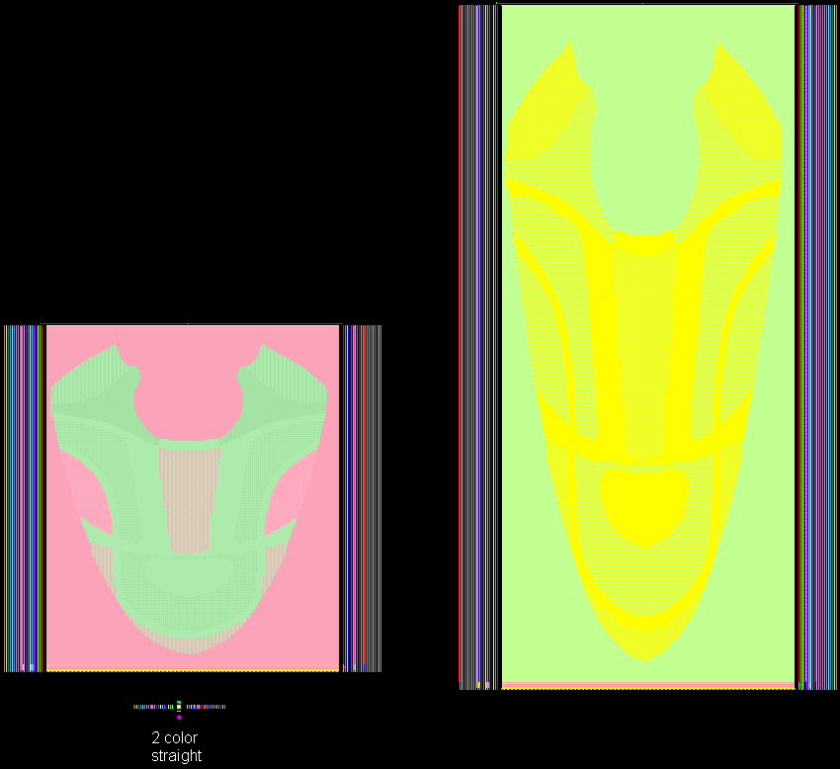

Slide 8
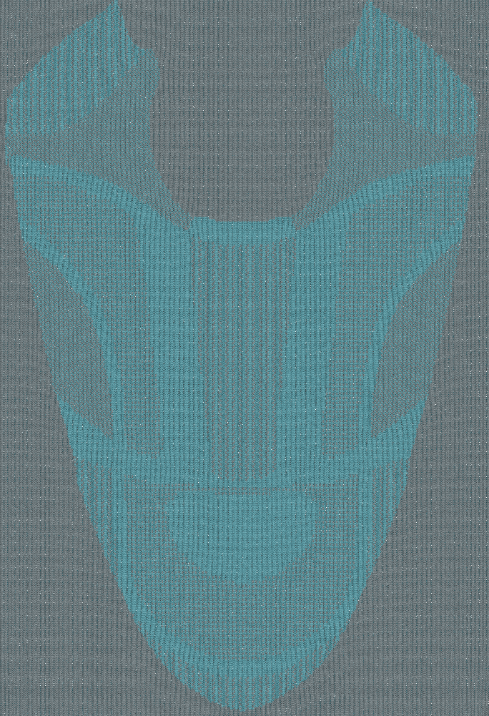
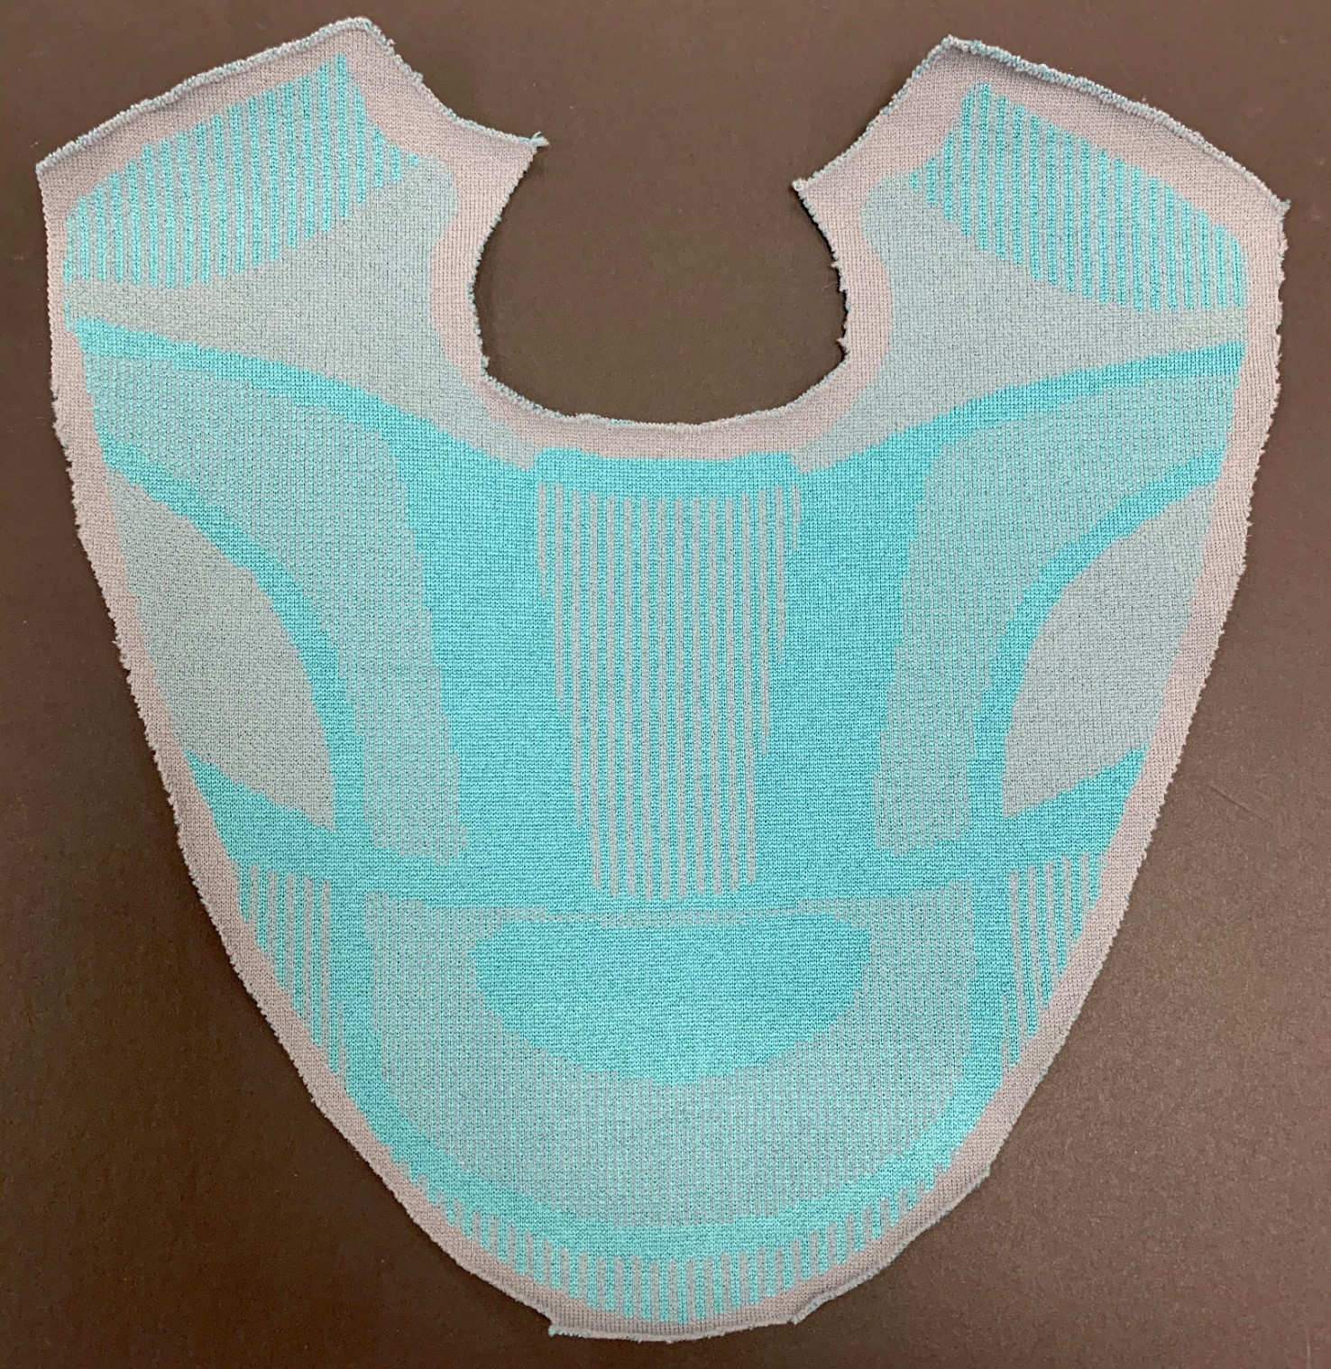

Slide 9
3 Color Jacquard
Package

Slide 13
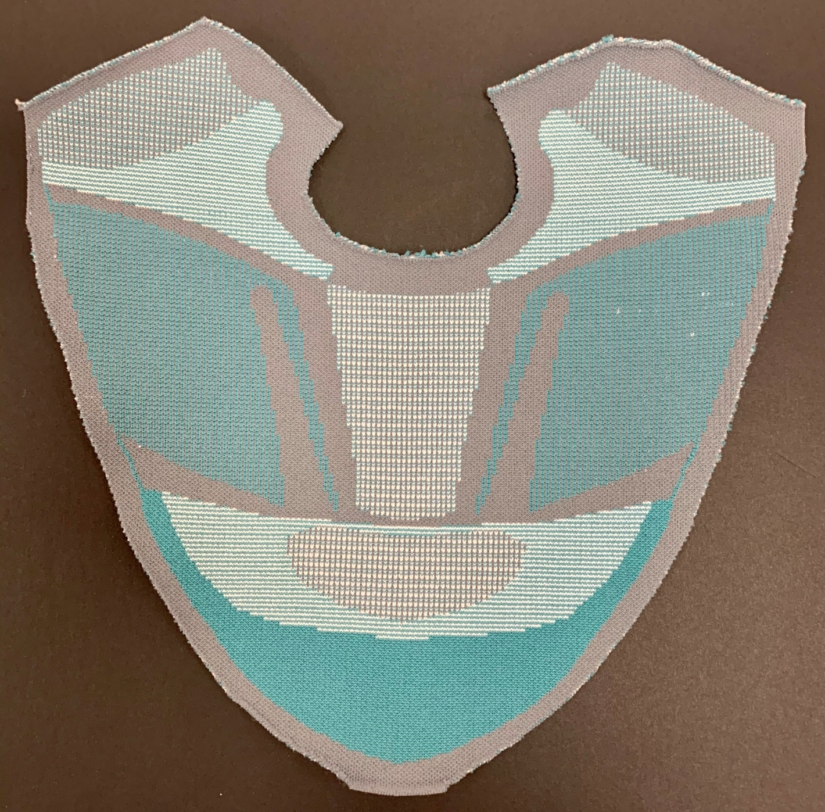

Slide 14
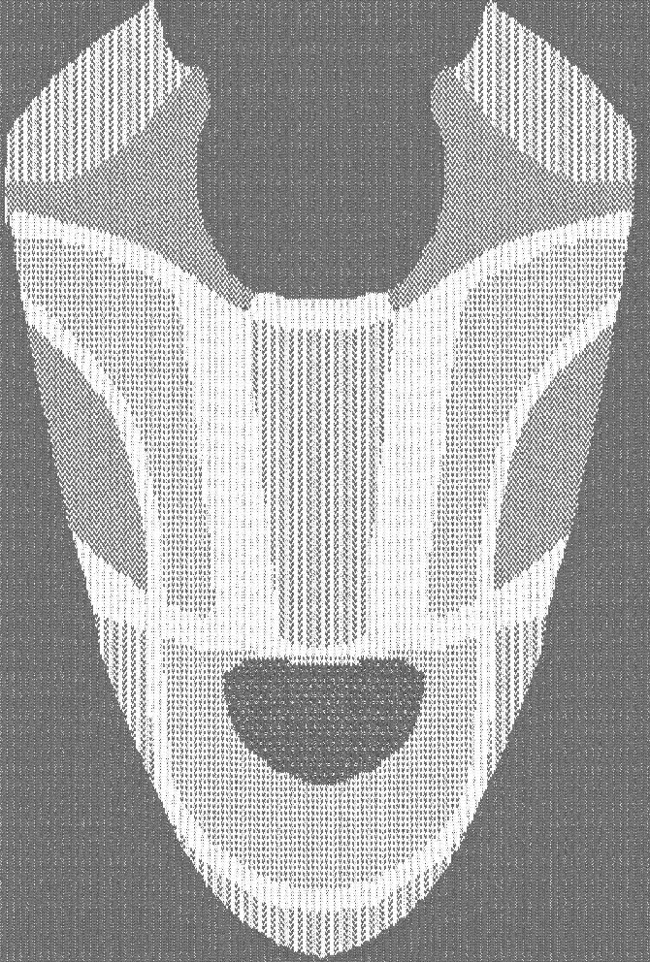
2-Color Mock Mesh Design

Slide 15
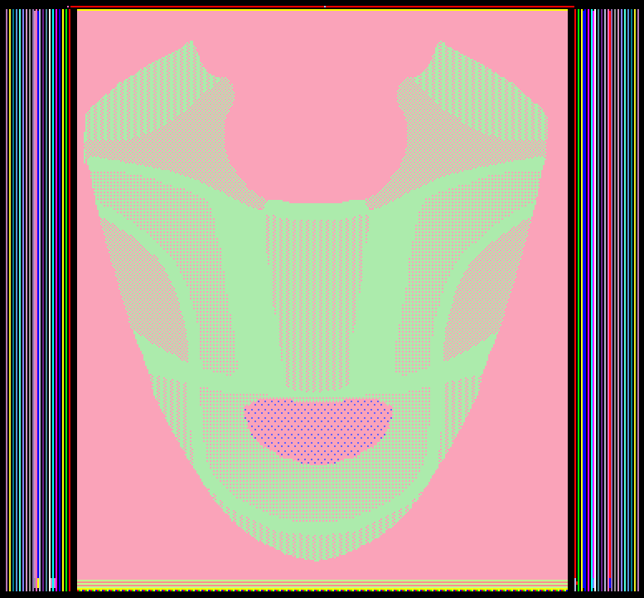
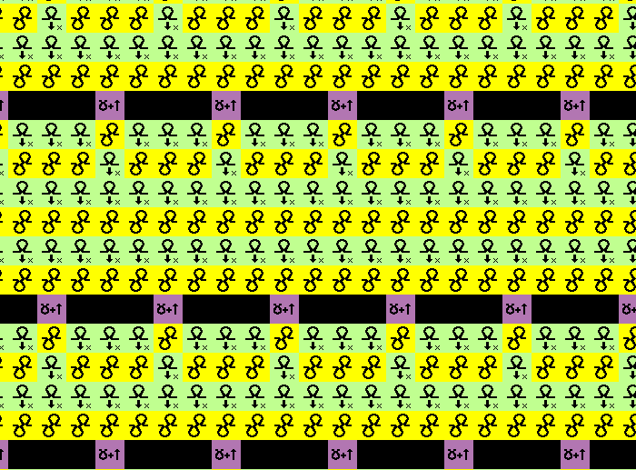

Slide 16
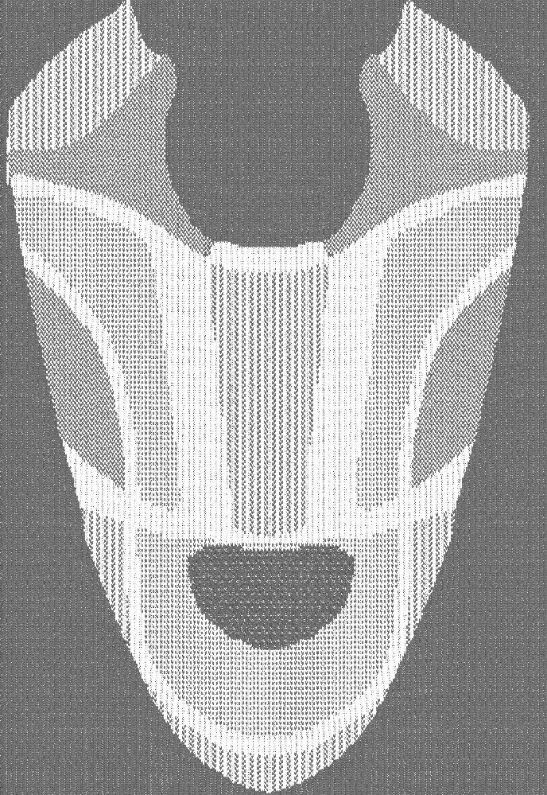
2-Color Mesh Design

